Slide 1





Group 6
Presentation
SPONGENT HASH

Slide 2







Team Members
Rohith Rajesh
2021BCY0001
Aswin A Nair
2021BCY0005
Blaize Tom
2021BCY0040
Priyanshi Chaturvedi
2C021BCY0030
Jean Joseph
2021BCY0003
Sai Surya
2021BCY0023
Komal Krishna
2021BCY0038

Slide 3
Introduction
Spongent is a lightweight cryptographic hash function designed for constrained devices like IoT and RFID systems. It follows a sponge construction, where input data is absorbed into a small internal state and then transformed through S-box substitutions and permutations before producing the final hash. Optimized for low power and minimal hardware resources, Spongent offers multiple variants (e.g., Spongent-88, Spongent-128) balancing speed and security. Compared to SHA-3, it is more efficient for embedded cryptographic applications, making it ideal for securing data in resource-limited environments.

Slide 4

Background
Spongent was introduced in 2011 by Alexandre Bogdanov, Meicheng Liu, Johann Knezevic, Gregor Leander, Francesco Regazzoni, and Ingrid Verbauwhede as part of the SHA-3 competition to provide a lightweight cryptographic hash function for constrained environments like IoT and embedded systems. It is based on the sponge construction, similar to Keccak (SHA-3), but optimized for hardware efficiency with a compact S-box and simple bitwise permutations. Spongent was developed to address the need for low-power, low-area cryptographic primitives in security-sensitive applications such as RFID authentication, sensor networks, and secure boot processes. It is part of the broader research into lightweight cryptography, ensuring security with minimal computational overhead.

Slide 5

Algorithm
Initialize State: Set up an internal state of size b = r + c with a predefined initial value.
Padding: If the input message length is not a multiple of r, apply padding to make it fit.
Absorption Phase:
Split the padded input into r-bit blocks.
XOR each r-bit block into the first r bits of the state.
Apply the permutation function to mix the state after each block absorption.
Permutation Function:
Apply an S-box substitution to introduce non-linearity.
Perform bit permutations to ensure diffusion.
Use XOR mixing between different state parts for randomness.
Apply circular shifting to prevent predictable patterns.
Squeezing Phase:
Extract the first r bits of the state as the output hash.
If additional bits are needed, apply more permutations and extract again.
Output Hash: Return the final extracted bits as the Spongent hash output.

Slide 6
Code
#include <Arduino.h>
#include <avr/pgmspace.h>
#define TRIG_PIN 9 // HC-SR04 Trigger Pin
#define ECHO_PIN 10 // HC-SR04 Echo Pin
#define HASH_SIZE 11 // 88-bit hash (11 bytes)
// S-box stored in PROGMEM to save RAM
const uint8_t SBOX[16] PROGMEM = {0x0, 0xE, 0xB, 0xD, 0xF, 0x7, 0x1, 0xC, 0x2, 0xA, 0x6, 0x8, 0x3, 0x9, 0x5, 0x4};
// Function to measure distance using HC-SR04
uint16_t getDistance() {
digitalWrite(TRIG_PIN, LOW);
delayMicroseconds(2);
digitalWrite(TRIG_PIN, HIGH);
delayMicroseconds(10);
digitalWrite(TRIG_PIN, LOW);
uint32_t duration = pulseIn(ECHO_PIN, HIGH);
uint16_t distance = duration * 0.034 / 2; // Convert to cm
return distance;
}
// Optimized Spongent-88 Hash Function
void spongent88(uint8_t *input, uint8_t *output, uint16_t length) {
uint8_t state[HASH_SIZE] = {0x5A, 0x3C, 0x7E, 0x1D, 0x2B, 0x4F, 0x8A, 0x6D, 0x9E, 0x77, 0xC3}; // Stronger initial state

Slide 7
// Absorption phase
for (uint16_t i = 0; i < length; i++) {
uint8_t index = i % HASH_SIZE;
state[index] ^= input[i]; // XOR input
state[(index + 3) % HASH_SIZE] ^= input[i]; // Spread effect
state[index] = pgm_read_byte(&SBOX[state[index] & 0xF]); // S-box Substitution
}
// Permutation step (stronger mixing)
for (uint8_t round = 0; round < 40; round++) { // More rounds for better diffusion
for (uint8_t i = 0; i < HASH_SIZE; i++) {
state[i] ^= (state[(i + 1) % HASH_SIZE] >> 3) ^ (state[(i + 2) % HASH_SIZE] << 2);
state[i] = (state[i] << 1) | (state[i] >> 7); // Circular left shift
state[i] ^= state[(i + 4) % HASH_SIZE]; // More non-linearity
}
}
// Squeezing phase
for (uint8_t i = 0; i < HASH_SIZE; i++) {
output[i] = state[i];
}
}
void setup() {
Serial.begin(115200);
pinMode(TRIG_PIN, OUTPUT);
pinMode(ECHO_PIN, INPUT);
}

Slide 8
void loop() {
uint16_t distance = getDistance();
Serial.print("Distance (cm): ");
Serial.println(distance);
// Convert distance to bytes
uint8_t inputData[2] = { (uint8_t)(distance >> 8), (uint8_t)(distance & 0xFF) };
uint8_t hashOutput[HASH_SIZE] = {0};
// Compute hash
spongent88(inputData, hashOutput, sizeof(inputData));
// Print hash output
Serial.print("Hashed Output (88-bit): ");
for (uint8_t i = 0; i < HASH_SIZE; i++) {
if (hashOutput[i] < 0x10) Serial.print("0"); // Ensure two-digit hex formatting
Serial.print(hashOutput[i], HEX);
Serial.print(" ");
}
Serial.println();
delay(1000); // Delay 1 second before next measurement
}

Slide 9
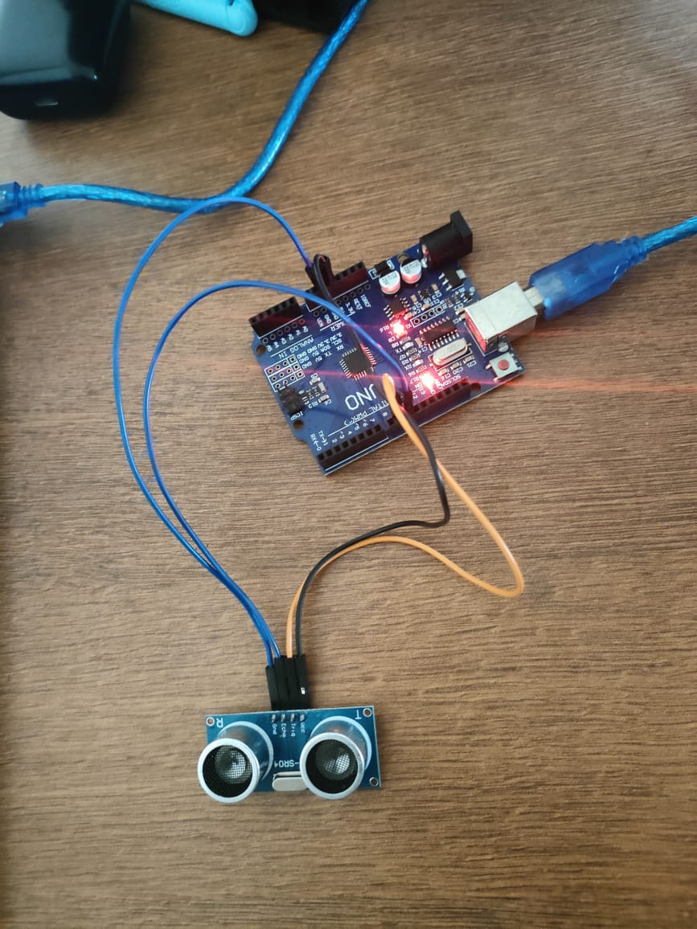
Setup

Slide 10


Slide 11

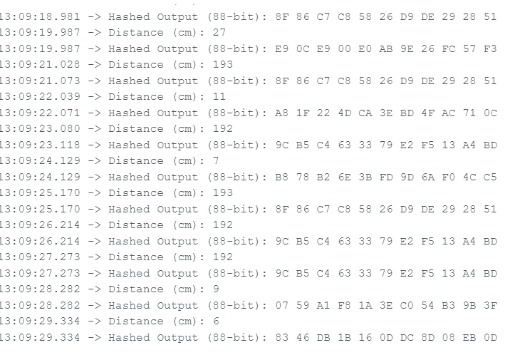
Output

Slide 12
Visualize Spongent Working
Visualizer
https://pythontutor.com/render.html#mode=display
Vizualized
Code
HASH_SIZE = 11 # 88-bit hash (11 bytes)
SBOX = [0x0, 0xE, 0xB, 0xD, 0xF, 0x7, 0x1, 0xC, 0x2, 0xA, 0x6, 0x8, 0x3, 0x9, 0x5, 0x4]
def spongent88(input_data):
state = [0x5A] * HASH_SIZE # Initialize state
# Absorption
for i, byte in enumerate(input_data):
state[i % HASH_SIZE] ^= byte
state[i % HASH_SIZE] = SBOX[state[i % HASH_SIZE] & 0xF]
# Simple permutation
for _ in range(5):
for i in range(HASH_SIZE):
state[i] ^= (state[(i + 1) % HASH_SIZE] >> 3)
return state
# Example input: 2-byte representation of distance
input_data = [0x12, 0x34]
hash_output = spongent88(input_data)
# Print hash output
print("Hashed Output:", " ".join(f"{byte:02X}" for byte in hash_output))

Slide 13
Conclusion
Spongent is a lightweight cryptographic hash function designed for resource-constrained environments such as IoT, RFID, and embedded systems. It leverages the sponge construction to provide efficient hashing with strong security properties. Its design ensures a balance between low computational cost and high resistance to cryptographic attacks.
Advantages of Spongent:
Lightweight and Efficient: Optimized for hardware and embedded systems with limited resources.
Flexible Output Size: Supports various digest lengths (e.g., 88-bit, 128-bit, etc.) for different security needs.
Strong Cryptographic Security: Provides resistance against collision, preimage, and differential attacks.
Low Memory Footprint: Uses minimal RAM and computational power, making it ideal for IoT and RFID applications.
Avalanche Effect: Ensures small input changes lead to significantly different hash outputs, enhancing security.
Overall, Spongent is a powerful yet efficient hash function suitable for modern security applications in low-power devices.

Slide 14
Reference
https://www.iacr.org/archive/ches2011/69170311/69170311.pdf

Slide 15
Thank You

